Slide 1
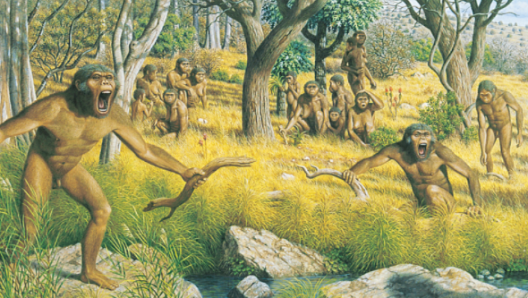
Ch 19 Human Ancestors
Intro
Effect of environment
Australopithecines

Slide 2
Introduction
Interest in human origins since Darwin wrote The Descent of Man in 1871
Speculation about what evolutionary transition between ape and human may involve
Scientists began searching for fossils
Neanderthal fossils had already been discovered
Dubois looked in the tropics – found Homo erectus fossil
Since, many more fossils have been found
Lots of discoveries in 1970s onward in Africa.

Slide 3
Effect of environment on Hominin Evolution
Evolution by natural selection meant environment must have favoured certain traits
Hominins originally lived in woodland environment
Ape-like
Arms and hands suited to arboreal lifestyle
May have used some bipedal movement to get through forest clearings – like modern Orangutans.
Environmental change 5-6 million years ago
Temperatures fell
Forest areas diminished
Open grassland increased

Slide 4
Effect of environment on Hominin Evolution
Increase in open grassland caused bipedalism and other traits to be advantageous
Increased range of vision to detect prey and predators
Increased height/size deterred predators
Hands free for carrying food, using tools etc
Higher reach to pick fruit or collect honey
Improved body cooling
Temperatures fell
Forest areas diminished
Open grassland increased
Food supply limited as forests replaced by grasslands
Evolutionary pressure
This was the time that Australopithecines were evolving

Slide 5
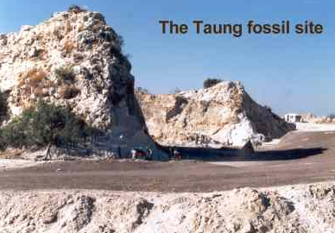
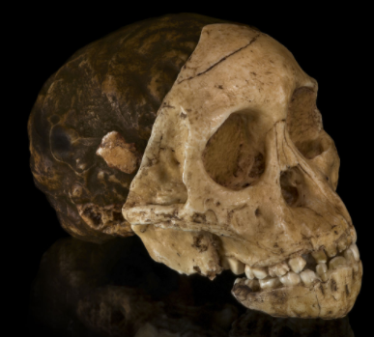
Australopithecines
First fossil found in early 1920s
Raymond Dart (an Aussie!)
Found in the limeworks at Taung
Realised skull was not of an ape
Juvenile skull of a hominin
Need to be cautious about juvenile skulls - naturally more rounded
Jaws and teeth were also different
Foramen magnum positionining
Concluded that the skull was from an ancestral hominin
“Taung Child” – named Australopithecus africanus

Slide 6
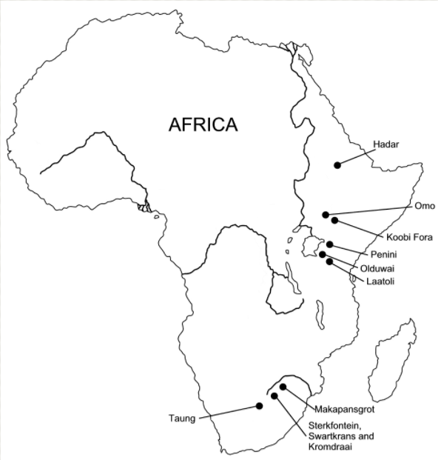

Slide 7
Australopithecines
Further fossils found
By Robert Broom, at Sterkfontein, in 1930s
Different fossil found at Kromdraai – Paranthropus robustus
1974: “Lucy” found in Hadar region of Ethiopia
40% complete female skeleton
3-3.6 million years old
Australopithecus afarensis
Laetoli footprints
3 hominids walked across wet volcanic ash Australopithecus afarensis
Left behind footprints showing bipedal locomotion
3.6 million years ago

Slide 8
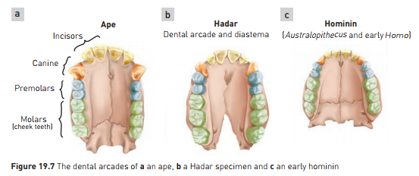
Australopithecines
Classification of Australopithecus afarensis
Dentition
Dental arcade comparison
Size of canines, cusp prominence on molars

Slide 9
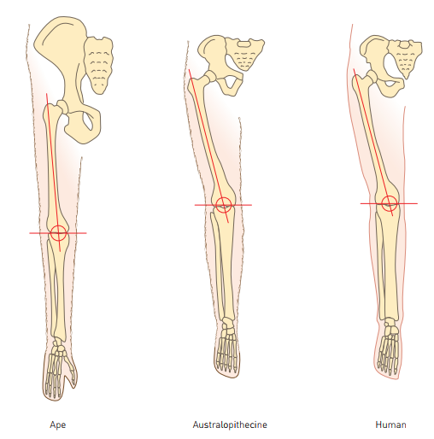
Australopithecines
Classification of Australopithecus afarensis
Femur and Pelvis
Footprints show bipedal gait, although not quite the same as modern humans
Pelvis and carrying angle more similar to modern humans than to apes

Slide 10
Anatomical features of Australopithecus
Teeth typically hominin:
Canines short and non projecting
No gap between canines and premolars
Parabolic dental arcade
Facial profile
Lower forehead, more projecting jaw than more modern hominins
Brain size 480cc, closer to modern gorilla than human
Relative brain size larger though: Australopithecus smaller than gorilla
Brain size and anatomy
Brain size 480cc, closer to modern gorilla than human
Relative brain size larger though: Australopithecus smaller than gorilla
Endocasts show brain more similar to humans in structure
Foramen magnum more forward than in apes
Skull more rounded in back than in apes

Slide 11
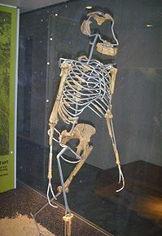
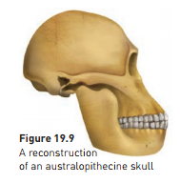
Anatomical features of Australopithecus
Limb bones
Suggest bipedal locomotion
Pelvic and foot bones typically hominin
Non opposable, strongly built big toe
Thumb less mobile than modern humans, but more so than modern apes
Vertebral column – typically hominin curves
Foramen magnum – at base of skull.

Slide 12
Variation within the Australopithecines
Probably several species within the genus Australopithecus
Two main variants seen: gracile and robust
Gracile: finer boned, slender
Robust: stockier, heavier, more muscular
Gracile | Robust
120-140cm tall | Up to 170cm tall
25-35 kg | Up to 70 kg
Proportional molars | Larger, broader molars
Smaller jaw muscles | Large jaw muscles and attachments
Australopithecus africanus Australopithecus afarensis | Now classified into a different genus: Paranthropus. Eg: Paranthropus robustus

Slide 13
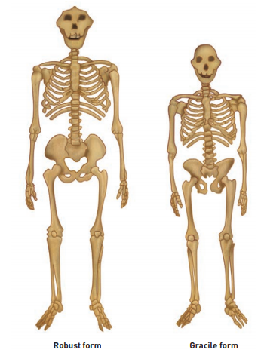

Slide 14
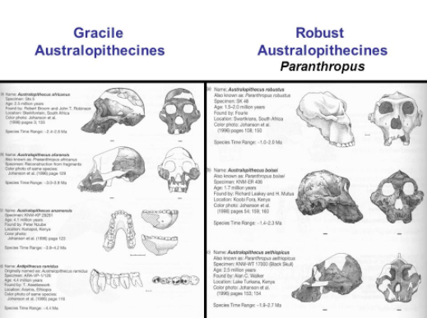

Slide 15
